Slide 1



AUTOMATED UNDERWRITING SYSTEM (AUS) FOR LOAN ELIGIBILITY
Members:
Emanwel Fernando Olea
Harvey Dangel
Christopher Gregory
Mary Rose D. Victoria
Syra C. Palo
Janrey Ponce Layon
Joylee Pearl Caboquing
Joderick Erispe
Marc Azelle Amaga

Slide 2
BACKGROUND of the PROBLEM
Various lending organizations have distinct lending requirements, including credit score thresholds.
Traditional underwriting processes are complex, time-consuming, and prone to human error due to extensive documentation and manual assessments.
Automation through AI and machine learning is a transformative force in lending, enabling digitalization, cost reduction, faster decision-making, and improved consumer experiences (Inscribe, 2020).
Determining loan eligibility is a pivotal step, involving a comprehensive assessment of financial status, creditworthiness, and risk potential.
Lending institutions, from traditional banks to online fintech firms, maintain unique criteria and standards, leading to a diverse and sometimes confusing lending landscape for borrowers.

Slide 3

IMPACT of the PROPOSAL
Enhanced Lending Practices
Improved Financial Literacy
Streamlined Borrowing
Reduced Loan Denials
Lending Technology Innovation
Foundation for Future Research

Slide 4
KNOWLEDGE ENGINEERING METHODS
Research Design
Data Collection
Data Collection Process
Data Analysis
Ethical Considerations
Limitations

Slide 5
RESULTS AND DISCUSSION
Age and Loan Application Approval
1. Age Group Characteristics
Younger Applicants (Age < 18)
Middle-Aged Applicants (Age 18-70)
Older Applicants (Age > 70)
2. Impact on Lending Decisions
Existing Loan and Loan Application Approval
1. Debt Load and Borrower Behavior
2. Managing Existing Debt
Residency Duration and Loan Application Approval
1. Community Ties and Stability
2. Trust Building

Slide 6
RESULTS AND DISCUSSION
Payment History and Loan Application Approval
1. Role of Payment History
2. Opportunities for New Clients
Collateral and Loan Application Approval
1. Role of Collateral
2. Collateral Types and Value
Debt-to-Income Ratio (DTI) and Loan Application Approval
1. Financial Stability Indicator
2. Responsible Borrowing

Slide 7
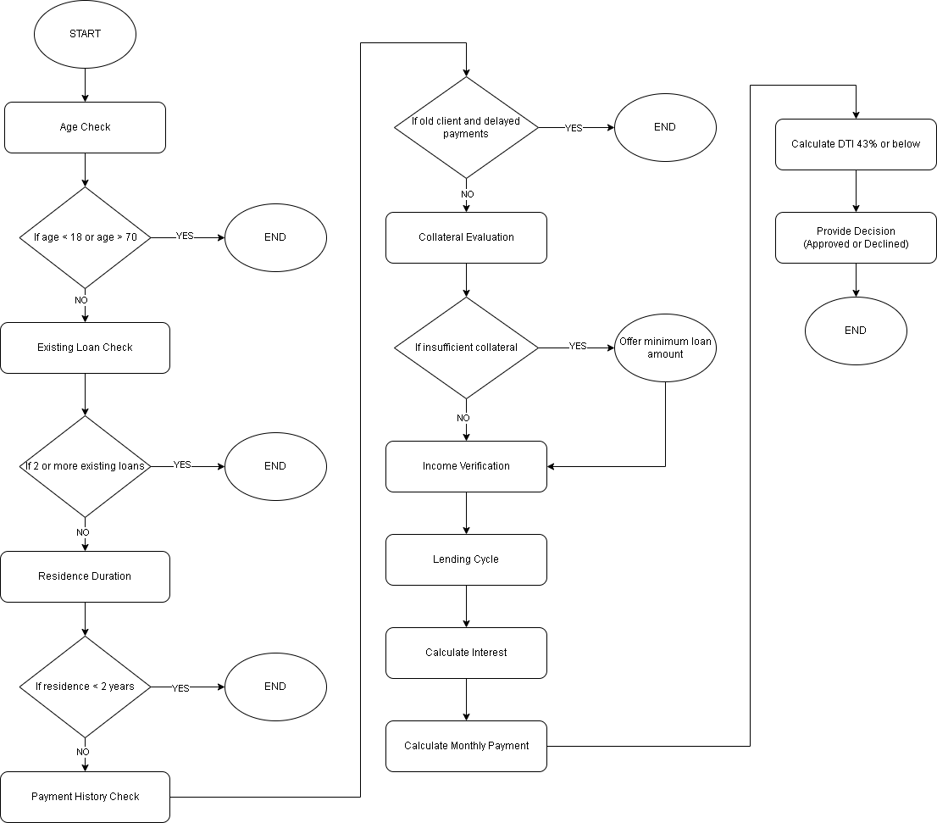
PROCESS FLOW VISUALIZATION

Slide 8
Thank you.

